Slide 1

Laravel Demo with
Laravel + Livewire
Bernando Torrez ☺

Slide 2
REFERENCE
Laravel : https://laravel.com/
Livewire : https://laravel-livewire.com/docs/2.x/quickstart

Slide 3
INTRODUCTION LARAVEL
What is Laravel?
Laravel is a web application framework with expressive, elegant syntax. We believe development must be an enjoyable, creative experience to be truly fulfilling. Laravel attempts to take the pain out of development by easing common tasks used in the majority of web projects, such as authentication, routing, sessions, and caching.
Laravel aims to make the development process a pleasing one for the developer without sacrificing application functionality. Happy developers make the best code. To this end, we've attempted to combine the very best of what we have seen in other web frameworks, including frameworks implemented in other languages, such as Ruby on Rails, ASP.NET MVC, and Sinatra.
Laravel is accessible, yet powerful, providing powerful tools needed for large, robust applications. A superb inversion of control container, expressive migration system, and tightly integrated unit testing support give you the tools you need to build any application with which you are tasked.

Slide 4
INTRODUCTION LARAVEL
Benefit of using Laravel?
Laravel makes implementing authentication very simple. Almost everything is configured out-of-the-box. Laravel also provides a simple way to organize authorization logic and control access to resources.
Laravel provides a clean, simple API over the popular SwiftMailer library. Laravel also provides drivers for SMTP, Mailgun, Mandrill, SparkPost, Amazon SES, PHP's “mail” function, and “sendmail”, allowing an application to quickly get started sending mail through a local or cloud-based service. In addition to support for sending email, Laravel provides support for sending notifications across a variety of delivery channels, including SMS (via Nexmo) and Slack.
Laravel supports popular cache backends like Memcached and Redis out-of-the-box. By default, Laravel is configured to use the file cache driver, which stores cached objects in the file system. For larger applications, it is better to use an in-memory cache such as Memcached or APC. However, with Laravel it is even possible to configure multiple cache configurations.

Slide 5
INTRODUCTION LARAVEL
Benefit of using Laravel? (2)
Laravel helps to secure the web application by protecting it against the most serious security risks: SQL injection, cross-site request forgery, and cross-site scripting. Laravel itself is secure. We can tell you first hand that the codebase is fanatically guarded, and that the code has been vetted by several people.
Error and exception handling is already configured for any new Laravel-based project. In addition, Laravel is integrated with the Monolog logging library, which provides support for a variety of powerful log handlers.
Laravel is built with testing in mind. In fact, support for testing with PHPUnit is included out-of-the-box and a phpunit.xml file is already setup for the application. The framework also ships with convenient helper methods allowing for expressive testing of the applications. It provides easy ways for simulating basic behavior of users (making requests to the application and examining the output, for example, clicking links, filling out forms).
Laravel is an MVC framework, so separation is already done.

Slide 6
INTRODUCTION LARAVEL
Benefit of using Laravel? (3)
All Laravel routes are defined in the app/Http/routes.php file, which is automatically loaded by the framework. The most basic Laravel routes simply accept a URI and a Closure, providing a very simple and expressive method of defining routes.
The Laravel queue service provides a unified API across a variety of different queue backends. Queues allow you to defer the processing of a time-consuming task, such as sending an e-mail, until a later time, which drastically speeds up web requests to your application.
in the past, developers have generated a Cron entry for each task they need to schedule. However, this is a headache. Such task schedule is no longer in source control, and developers must SSH into the server to add the Cron entries. The Laravel command scheduler allows for the fluent and expressive defining of command schedule within Laravel itself, and only a single Cron entry is needed on the server.

Slide 7
INTRODUCTION LIVEWIRE
What is Livewire?
Livewire is a library that makes it simple to build modern, reactive, dynamic interfaces using Laravel Blade as your templating language. This is a great stack to choose if you want to build an application that is dynamic and reactive but don't feel comfortable jumping into a full JavaScript framework like Vue.js or another JavaScript UI Library.
You just code with PHP to make your website is interactive.

Slide 8
INTRODUCTION LIVEWIRE
Benefit of using Livewire?
Real-Time Data Binding using “wire:model”.
Interactive website just using PHP.
You don’t need to write any JavaScript Code.
Real-Time Data Validation.
No-Reload Page (Single Page Application) feels using “Turbolink”

Slide 9
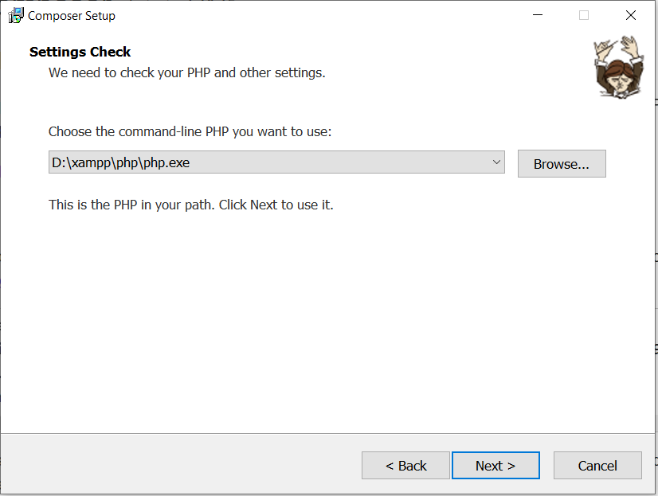
INSTALLATION LARAVEL
Install Latest Xampp (PHP >= 7.3).
Install Composer
-> if you install two or more Xampp, locate your installation Composer to Xampp having PHP >= 7.3, my example that I installed xampp in D:

Slide 10
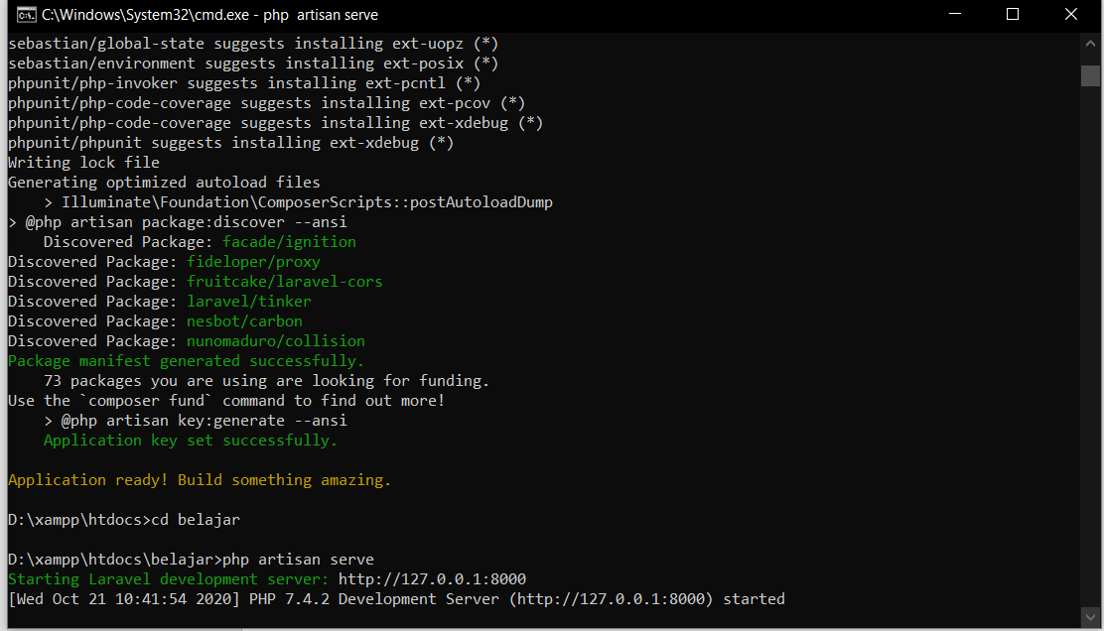
INSTALLATION LARAVEL (2)
Install Laravel Installer using Composer CLI (Command Line)
-> Open CMD, then run “composer global require laravel/installer”
this will install Laravel into your system.
Install Laravel to your htdocs.
-> Open CMD, change directory to htdocs.
-> run “laravel new belajar_laravel”, wait until the process done.
-> run “php artisan serve”

Slide 11
INSTALLATION NODE JS
Go to Node Js download page : https://nodejs.org/en/download/
Choose Windows Installer
And Install like Usual

Slide 12
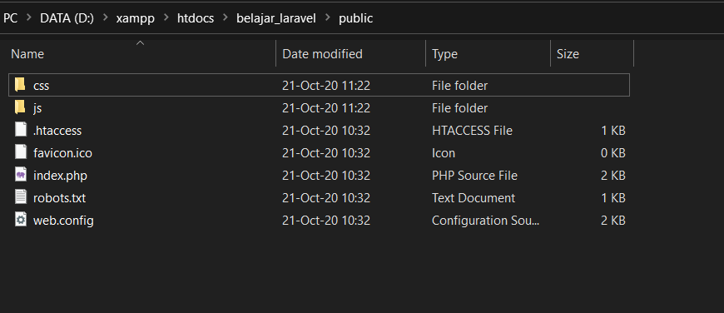
LARAVEL x BOOTSTRAP
Download Bootstrap Assets
-> bootstrap : https://github.com/twbs/bootstrap/releases/download/v4.5.3/bootstrap-4.5.3-dist.zip
-> jquery : https://code.jquery.com/jquery-3.5.1.slim.min.js
Extract and Copy Paste to belajar_Laravel “public” folder.

Slide 13
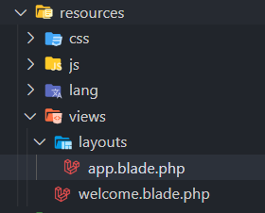
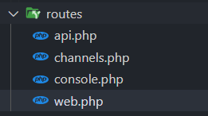
LARAVEL x BOOTSTRAP (2)
1. Create “root views”
Create folder “layouts” in “resources” then create file “app.blade.php”
Lets make simple HTML to our “app.blade.php”
-> my example html : https://pastebin.com/raw/mYgChKE8
Go to “routes” folder, then open “web.php”

Slide 14

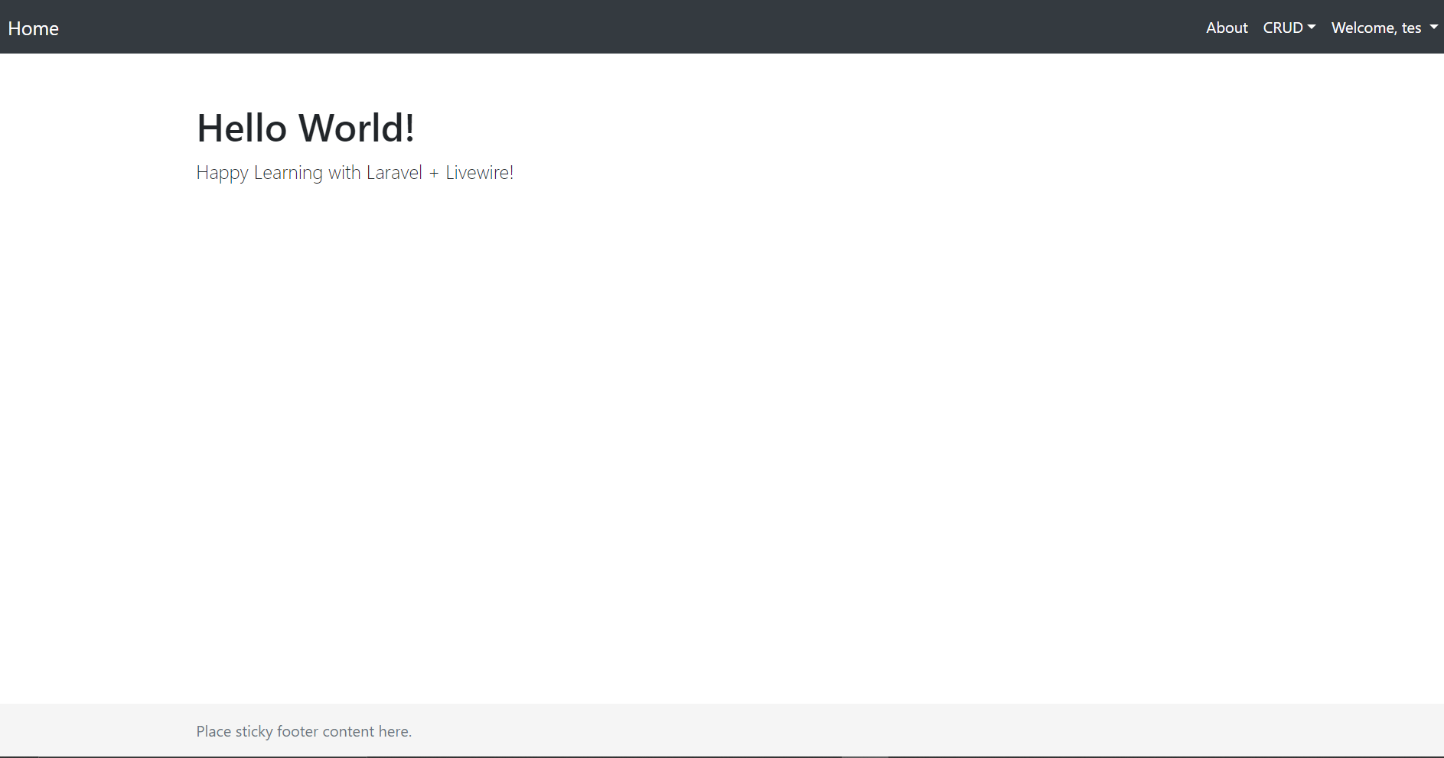
LARAVEL x BOOTSTRAP (3)
1. Create “root views”
Then edit Route::get(‘/’) to like the image.
Then refresh the page or open :
-> http://127.0.0.1:8000/

Slide 15
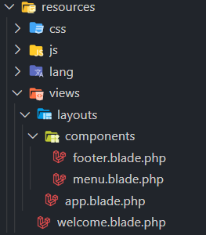

LARAVEL x BOOTSTRAP (4)
2. Refactor our “root views” into several component (menu, footer, content)
Create “components” folder in “layouts” folder.
Then create file “menu.blade.php” and “footer.blade.php”
Open “menu.blade.php”,
Then copy paste : https://pastebin.com/raw/wQztHE6E
Open “footer.blade.php”
Then copy paste : https://pastebin.com/raw/3DcSfUrm
Then refactor “app.blade.php” with @include : https://pastebin.com/raw/MdisfZH7
-> layouts.components.menu is equal to layouts/components/menu

Slide 16
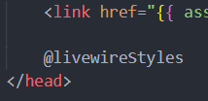
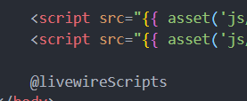
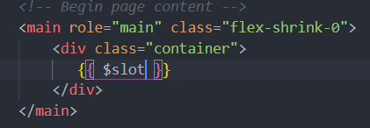
INSTALLING LIVEWIRE
1. Install Livewire using Composer
Open CMD, then run “composer require livewire/livewire”
Include livewire code (@livewireStyles and @livewireScripts) into our “app.blade.php”
Change our content HTML to livewire content with $slot

Slide 17

INSTALLING LIVEWIRE (2)
2. Create Livewire components
Open CMD, then run “php artisan make:livewire pages.home.home-index”
-> Would you like to show some love by starring the repo? (yes/no) [no]: enter
-> it will create folder under app/http/livewire/pages/home/HomeIndex.php (Controller)
-> and under resources/livewire/pages/home/home-index.blade.php (view)
2. Then I’ll create livewire component for about pages
-> run “php artisan make:livewire pages.about.about-index”
-> it will create folder under app/http/livewire/pages/about/AboutIndex.php’ (Controller)
-> and under resources/livewire/pages/about/about-index.blade.php (view)
3. Then we must register that livewire Controller to our routes/web.php
-> call AboutIndex.php and HomeIndex.php
at the top with use keyword php :
-> register livewire controller route :
-> ‘/’ is equal to http://localhost/
-> ‘/home’ is equal to http://localhost/home
-> ‘/about’ is equal to http://localhost/about

Slide 18





INSTALLING LIVEWIRE (3)
3. Rendering Livewire components
Edit livewire view ‘livewire/pages/home/home-index.php’ :
Edit livewire view ‘livewire/pages/about/about-index.php’ :
Change URL in 'menu.blade.php’
-> open ‘layouts/components/menu.blade.php’, then change URL :
4. Reload your page, and try to click the menu!
5. Next, we’ll create Single Page Application (SPA) !, (no-reload page)

Slide 19

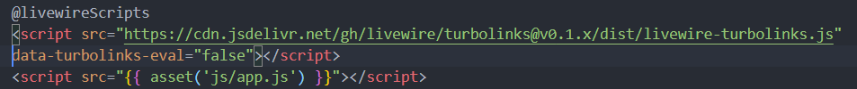
INSTALLING LIVEWIRE (4)
4. Single Page Application with Turbolink
Install turbolinks using npm (nodejs package manager)
-> npm install --save turbolinks
Register turbolinks to folder ‘resources/js/app.js’
Compiling ‘resources/js/app.js’
-> Open CMD, run “npm install && npm run dev”
Call compiled app.js to our “root views” (app.blade.php) and add additional turbolink javascript
And try to reload the page, and try to click the menu, our page not reloading now when we move to another page! Amazing!

Slide 20

LIVEWIRE FEATURE (DATA BINDING)
Okay, I’ll show you one feature of Livewire called Data Binding
Change our livewire component “livewire/pages/home/home-index.blade.php”
-> https://pastebin.com/raw/i4YG8sjC
Change our livewire controller “livewire/pages/home/HomeIndex.php”
-> https://pastebin.com/raw/u3Hz8y2p
3. Reload page and try to click + Button

Slide 21
LIVEWIRE FEATURE
(REAL-TIME VALIDATION)
Okay, because Validation is Important, Livewire make a real-time validation for us, and it will be more Amazing!
Update our component menu on “resources/layouts/components/menu.blade.php”
-> https://pastebin.com/raw/bHKk9VHX
Create new livewire component “karyawan”
-> open CMD, run “php artisan make:livewire pages.karyawan.karyawan-index”
Edit livewire view karyawan “resources/livewire/pages/karyawan/karyawan-index.blade.php”
-> https://pastebin.com/raw/UDBbJibf
Edit livewire controller “livewire/pages/karyawan/KaryawanIndex.php” to make a Validation to karyawan-index.blade.php
-> https://pastebin.com/raw/NHYdfW6J
Reload page, go to menu CRUD->Add Data and try to fill empty form, and the Validation Message will show to you at the real-time!

Slide 22
LIVEWIRE CREATE DATA TO DATABASE
1. Create Karyawan Model (Table)
Open CMD, run “php artisan make:model Karyawan -m” (-m = make Migration file)
Open Karyawan Migration, then change like this : https://pastebin.com/raw/9zvsb02U
Open Karyawan Model “app/models/Karyawan.php”
-> change to : https://pastebin.com/raw/52j8SiXZ
Run Database Migration “php artisan migration”
Back to our karyawan livewire controller “livewire/pages/karyayan/KaryawanIndex.php”
-> change to : https://pastebin.com/raw/LNCghJ3M
Reload the page, and try to insert karyawan Data, and boom! Data on table will Update at the Real-Time without Reloading the page, Amazing!

Slide 23
LIVEWIRE CREATE DATA TO DATABASE
1. Create Karyawan Model (Table)

Slide 24
LIVEWIRE UPDATE DATA TO DATABASE
2. Update Karyawan Model (Table)
Open karyawan livewire view “layouts/pages/karyawan/karyawan-index.blade.php”
-> change to : https://pastebin.com/raw/gXWkymGj
Open karyawan livewire controller “livewire/pages/karyawan/KaryawanIndex.php”
-> change to : https://pastebin.com/raw/DLKfTfcS
Reload the page, and try to update karyawan Data, and boom! Data on table will Update at the Real-Time without Reloading the page, Amazing!

Slide 25
LIVEWIRE CREATE DATA TO DATABASE
2. Update Karyawan Model (Table)

Slide 26
LIVEWIRE DELETE DATA TO DATABASE
3. Delete Karyawan Model (Table)
Open karyawan livewire view “layouts/pages/karyawan/karyawan-index.blade.php”
-> change to : https://pastebin.com/raw/QXKKE9XQ
Open karyawan livewire controller “livewire/pages/karyawan/KaryawanIndex.php”
-> change to : https://pastebin.com/raw/Nam6TCjq
Reload the page, and try to delete karyawan Data, and boom! Data on table will Update at the Real-Time without Reloading the page, Amazing!

Slide 27
LIVEWIRE CREATE DATA TO DATABASE
3. Delete Karyawan Model (Table)

Slide 28
LIVEWIRE FEATURE (DATA BINDING)
Okay enough, I’ll update Tomorrow
Source Code : https://github.com/bernandotorrez/laravel-livewire

